Slide 1
07 Clustering

Slide 2
Unsupervised Learning
• The training data you feed to the algorithm is unlabeled.
• The goal is usually to understand the input data better.
No. | 𝑥₁ | 𝑥₂
1
2
3
4
5
Label
New findings
about the
input data
algori thm

Slide 3
Cluster Analysis
• Cluster analysis groups data objects based only on information found in the data that describes the objects.
클러스터 분석은 개체를 설명하는 데이터에서 찾은 정보만을 기반으로 데이터 개체를 그룹화한다.
• The goal is that the objects within a group be similar to one another and different from the objects in other groups.
목표 : 그룹 내의 개체가 서로 유사하고 다른 그룹의 개체와 다른 것
• Clustering is usually followed by another exploratory analysis.
• e.g., explore data within a specific group, labeling, etc.
클러스터링은 일반적으로 또 다른 탐색적 분석이 뒤따른다.

Slide 4
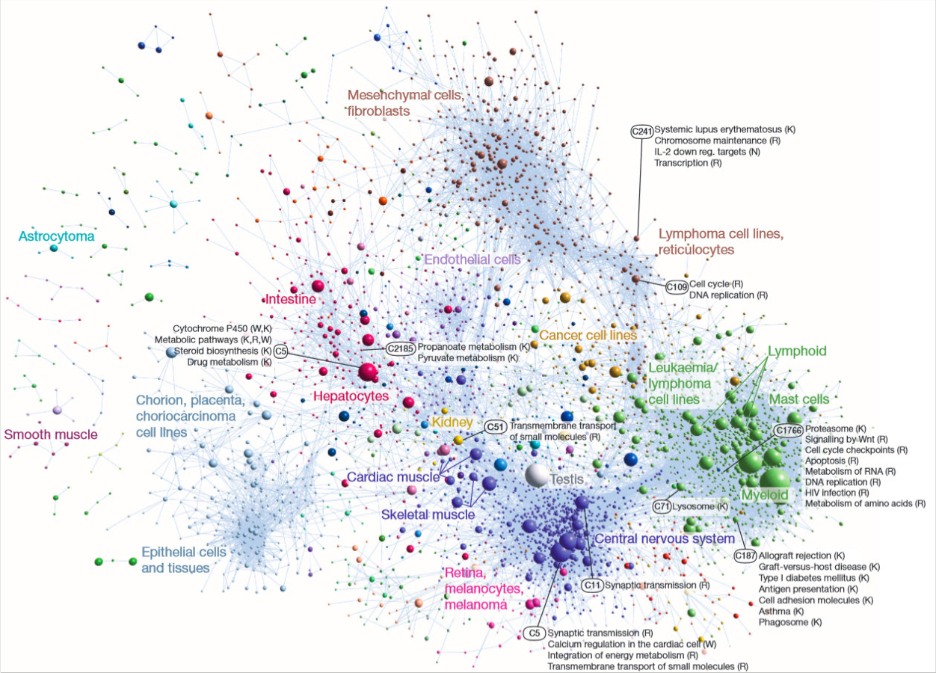
Applications of Cluster Analysis
• Biology
• Biologists have applied clustering to analyze the large amounts of genetic information that are now available.
유전정보 분석 – 유사한 기능 가진 유전자 그룹을 찾는 데 사용
• For example, clustering has been used to find groups of genes that have similar functions.
Source: http://www.kurzweilai.net/first-comprehensive-atlas-of-human-gene-activity-released

Slide 5
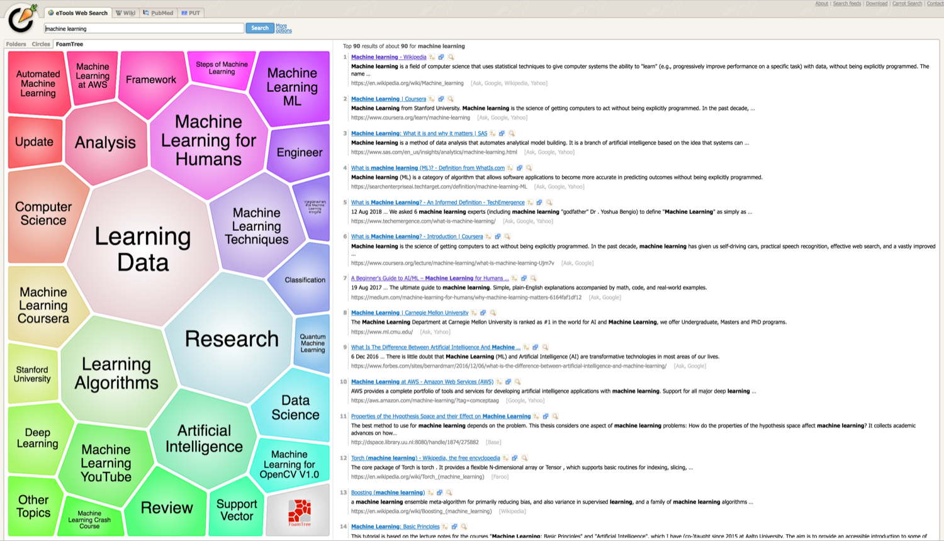
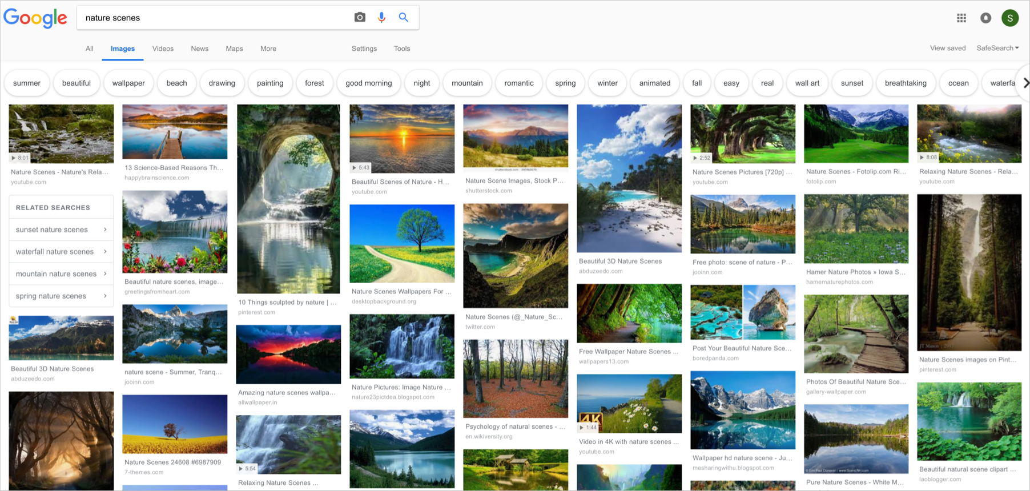
Applications of Cluster Analysis
• Information Retrieval (정보검색)
• Clustering can be used to group search results into a small number of clusters, each of which captures a particular aspect of the query.
각 클러스터 쿼리의 특정 측면을 캡쳐한다. 검색 결과를 클러스터링 함.
• For example, a query of “movie” might return web pages grouped into categories such as reviews, trailers, stars, and theaters.
영화 – 리뷰, 예고편, 스타, 극장 등 그룹화 된 페이지를 반환할 수 있음.
Source: search.carrot2.org/
Source: google.com

Slide 6
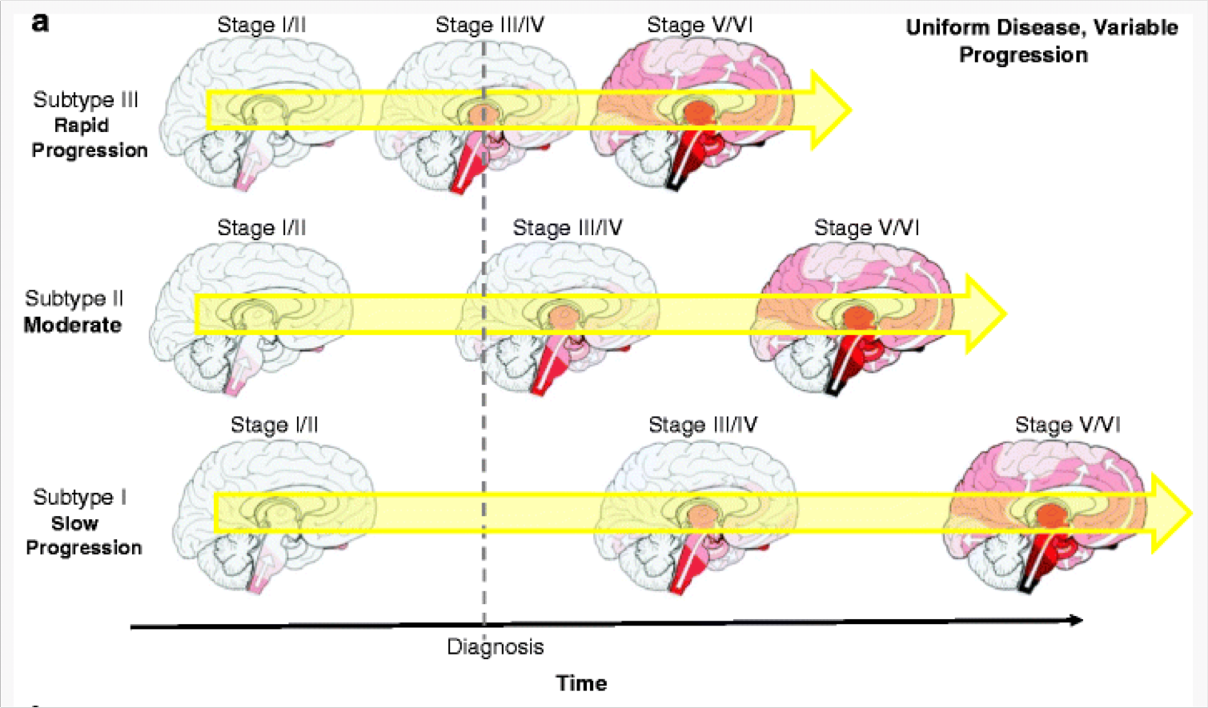
Applications of Cluster Analysis
• Medicine
• An illness or condition frequently has a number of variations, and cluster analysis can be used to identify these different subcategories.
• For example, clustering has been used to identify different types of Parkinson’s disease.
질병의 하위 범주 식별이 가능
파킨슨병 식별에 사용되었다.
Source: https://link.springer.com/article/10.1007/s11910-017-0738-x

Slide 7
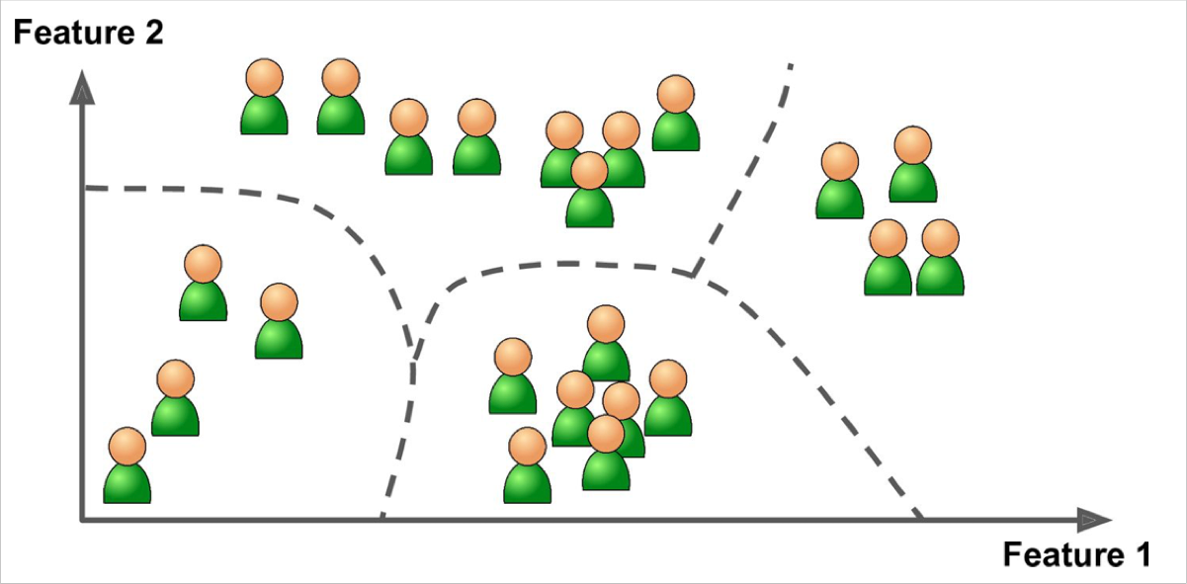
Applications of Cluster Analysis
• Business
• Businesses collect large amounts of information on current and potential customers.
• Clustering can be used to segment customers into a small number of groups for additional analysis and marketing activities.
기업은 현재 및 잠재 고객에 대한 많은 양의 정보를 수집한다.
마케팅을 위해 고객 클러스터링을 한다.

Slide 8
Techniques
• Prototype-based clustering
• K-means clustering
• Density-based clustering
• DBSCAN
• Spectral clustering

Slide 9
Prototype-based clustering
• Prototype-based clustering means that each cluster is represented by a prototype.
• K-means
• K-means defines a prototype in terms of a centroid, which is usually the mean of a group of points.
• A centroid does not correspond to an actual data point.
점 그룹의 평균인 중심을 기준으로 원형을 정의합니다. 중심은 실제 데이터 포인트와 일치하지 않음
• K-medoids
• K-medoids defines a prototype in terms of a medoid, which is the most representative point for a group of points.
• A medoid is an actual data point.
점들의 그룹에 대한 가장 대표적인 점인 Medoid 관점에서 프로토 타입을 정의하고, medoid는 실제 데이터 포인트

Slide 10
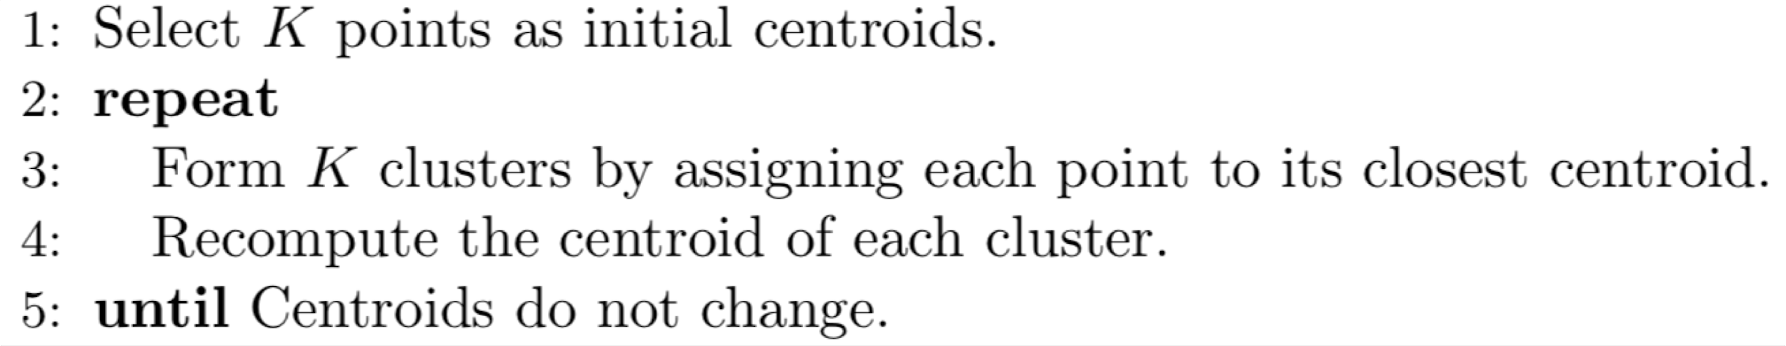
K-means Clustering
• K-means is a prototype-based technique that attempts to find a user- specified number of clusters (K), which are represented by their centroids.
중심으로 표시되는 사용자 지정 클러스터 수를 찾으려고 시도하는 기술
• Algorithm

Slide 11
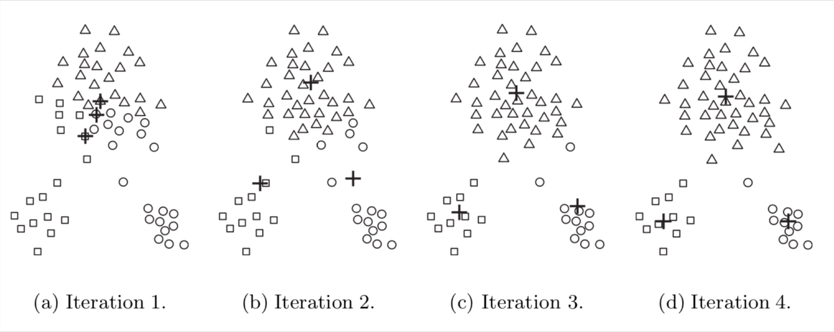
K-means Clustering
• The centroids are indicated by the “+” symbol; all points belonging to the same cluster have the same marker shape.
중심은 + 기호로 표시됩니다. 동일한 클러스터에 속한 모든 포인트는 모양 같음
• Iterations
• (a): Points are assigned to the initial centroids.
• (b) – (d):Two of the centroids move to the two small groups.

Slide 12
K-means Clustering
• K-means converges to a solution.
• K-means reaches a state in which no points are shifting from one cluster to another, and hence, the centroids don’t change.
한 클러스터가 다른 클러스터로 포인트가 이동하지 않는 상태에 도달하여 중심이 변하지 않을 때 솔루션으로 수렴한다.
• Termination condition
• K-means terminates when centroids do not change.
• A weak condition can be used, e.g., terminates when less than 1% of the points change clusters.
중심이 변경되지 않을 때 / 약한 조건 (1% 미만의 변경)

Slide 13
K-means Clustering
• Assigning points to the closest centroid.
• To assign a point to the closest centroid, we need a proximity measure.
• Manhattan (L1) distance
• Euclidean (L2) distance
• And more..
• The similarity measures used for K-means are usually relatively simple since the algorithm repeatedly calculates the similarity of each point to each centroid.
K-평균에 사용되는 유사성 측정은 알고리즘이 각 중심에 대한 각 점의 유사성을 반복적으로 계산하기 때문에 일반적으로 비교적 간단합니다.

Slide 14
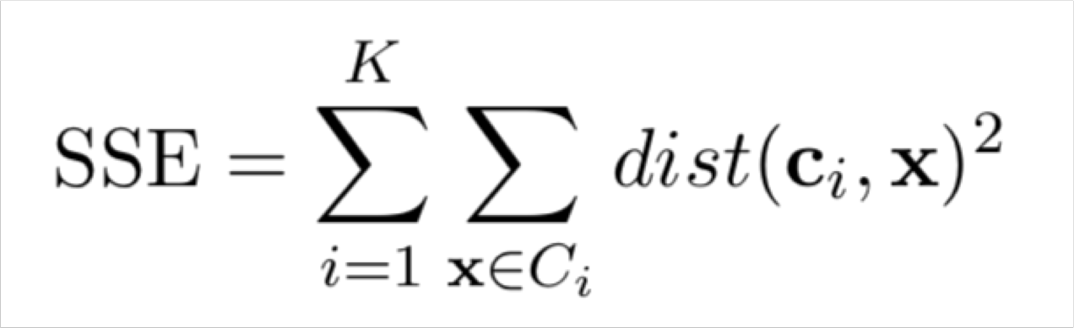
K-means Clustering
• Use an objective function to measure the quality of a clustering.
• Sum of the squared error (SSE)
목적함수를이용하여 클러스터링의 품질을 측정합니다 – 제곱오차의 합
• Steps
• Calculate the error of each data point, i.e., its Euclidean distance to the closest centroid.
• Then compute the total sum of the squared errors.
각 데이터 포인트까지의 오차, 가장 가까운 중심까지의 유클리디안 거리를 계산한다.
그리고나서 다음 제곱 오차의 총합을 계산
• Given multiple sets of clusters, the one with the smallest SSE is the best clustering result.
여러 개의 클러스터링이 있는 경우 SSE 가 가장 작은 집합이 최상의 결과이다.

Slide 15
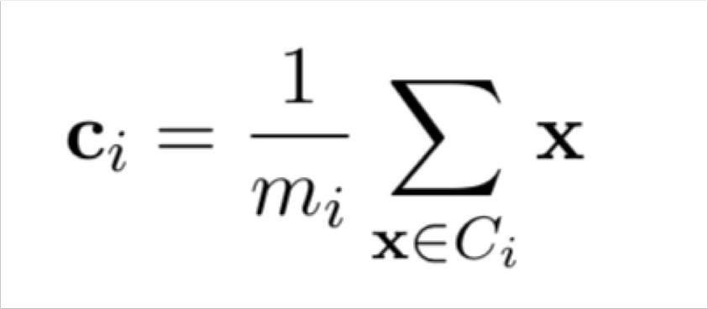
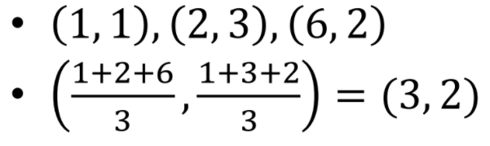
K-means Clustering
• Use an objective function to measure the quality of a clustering.
• Centroid (mean) of the ith cluster
목적함수를 사용하여 클러스터의 품질을 측정한다.
• Example

Slide 16
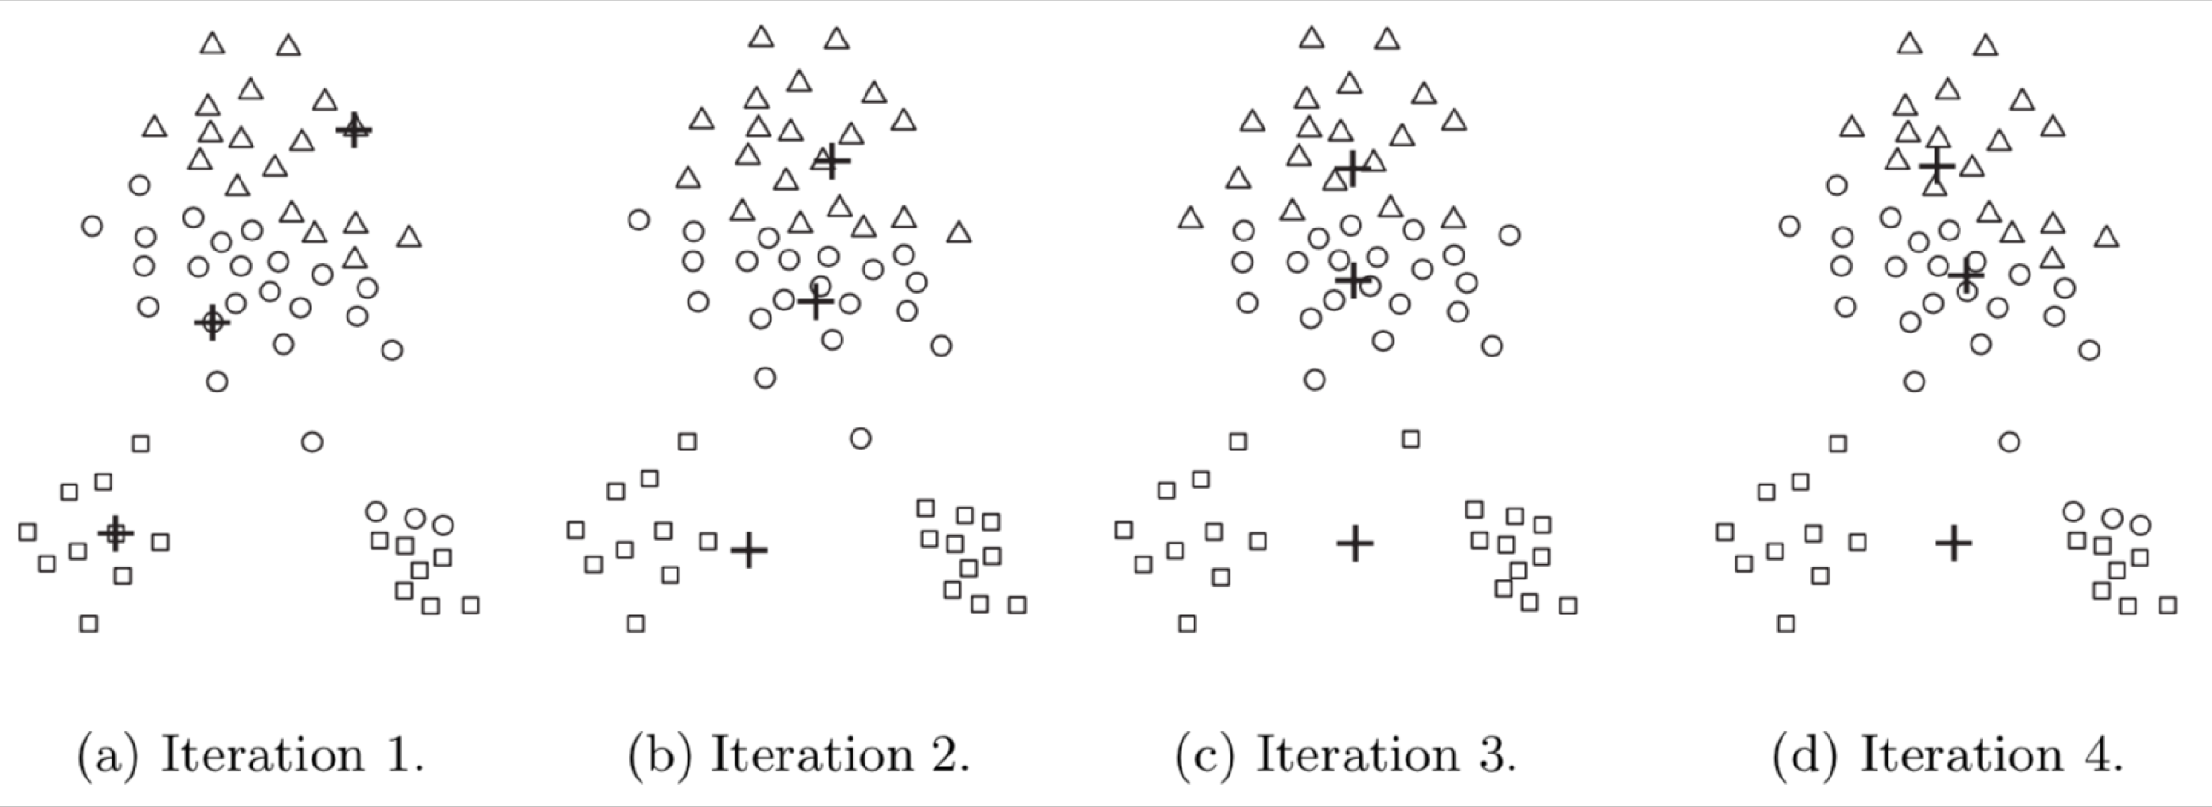
K-means Clustering
• Choose initial centroids
• Selected initial centroids may be poor.
선택한 초기 중심이 좋지 않을 수 있습니다.
• Random initialization
• Perform multiple runs, each with a different set of randomly chosen initial centroids, and then select the set of clusters with the minimum SSE.
각기 다른 무작위로 선택된 초기 중심 셋을 사용하여 여러 번 돌리고,
최소 SSE 가 있는 클러스터를 선택한다.

Slide 17
K-means Clustering Issues
• Handling empty clusters 빈클러스터 처리
• Empty clusters can be obtained if no points are allocated to a cluster.
• The strategy is to choose a replacement centroid.
전략 : 대체 중심을 선택
• Choose the point that is farthest away from any current centroid. (This eliminates the point that currently contributes most to the total squared error)
현재 중심에서 가장 멀어진 점을 선택(이는 총 제곱 오차에 많이 기여하는 점을 제거함)
• Choose the replacement centroid from the cluster that has the highest SSE. (This will typically split the cluster and reduce the overall SSE of the clustering)
SSE 가 가장 높은 클러스터에서 교체 중심을 선택합니다. (이는 일반적으로 클러스터를 분할하고 클러스터링의 전체 SSE를 줄입니다. )

Slide 18
K-means Clustering Issues
• Outliers 이상치
• Outliers can unduly influence the clusters that are found.
이상치가 클러스터에 과도한 영향을 끼칠 수 있음
• When outliers are present, the resulting cluster centroid may not be representative and the SSE will be higher as well.
아웃라이어가 있는 경우 결과중심중심이 대표성이 아닐 수 있으며, SSE도 더 높아진다.
• The strategy is to eliminate outliers. However, in some applications, outliers should not be eliminated.
전략은 이상치 제거하는 것.
• E.g., in financial analysis, unusually profitable customers are outliers, but are the most interesting points as well.

Slide 19
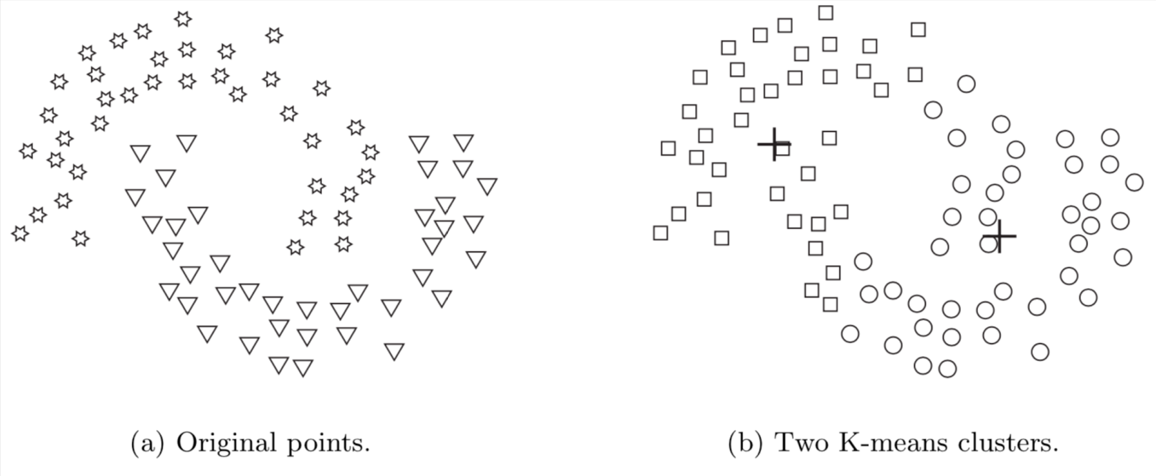
K-means Clustering & Types of Clusters
• 클러스터가 원형이 아닐 경우
K-means has difficulty detecting the “natural” clusters, when clusters have non-spherical shapes.
• K-means finds two clusters that mix portions of the two natural clusters because the shape of the natural clusters is not globular.
.

Slide 20
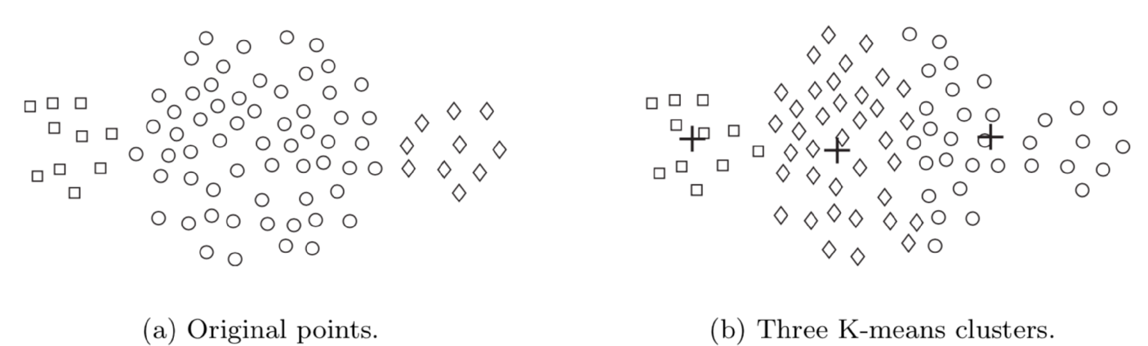
K-means Clustering & Types of Clusters
• 클러스터의 크기가 다를 경우
K-means has difficulty detecting the “natural” clusters, when clusters have widely different sizes.
• K-means cannot find the three natural clusters because one of the clusters is much larger than the other two, and hence, the larger cluster is broken, while one of the smaller clusters is combined with a portion of the larger cluster

Slide 21
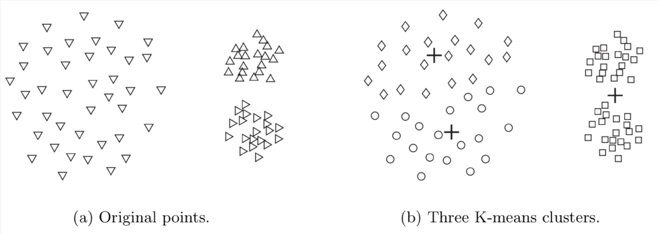
K-means Clustering & Types of Clusters
• 클러스터의 밀도가 다를 경우
K-means has difficulty detecting the “natural” clusters, when clusters have widely different densities.
• K-means fails to find the three natural clusters because the two smaller clusters are much denser than the larger cluster.

Slide 22
Density-based Clustering
• In density-based clustering, clusters are defined as regions of high density.
밀도 기반 클러스터링에서 클러스터는 고밀도 영역으로 정의
• Density-based clustering locates regions of high density that are separated from one another by regions of low density.
밀도 기반 클러스터링은 밀도가 낮은 영역으로 서로 분리되어 있는 고밀도 영역을 찾음
• Defining density
• Center-based approach

Slide 23
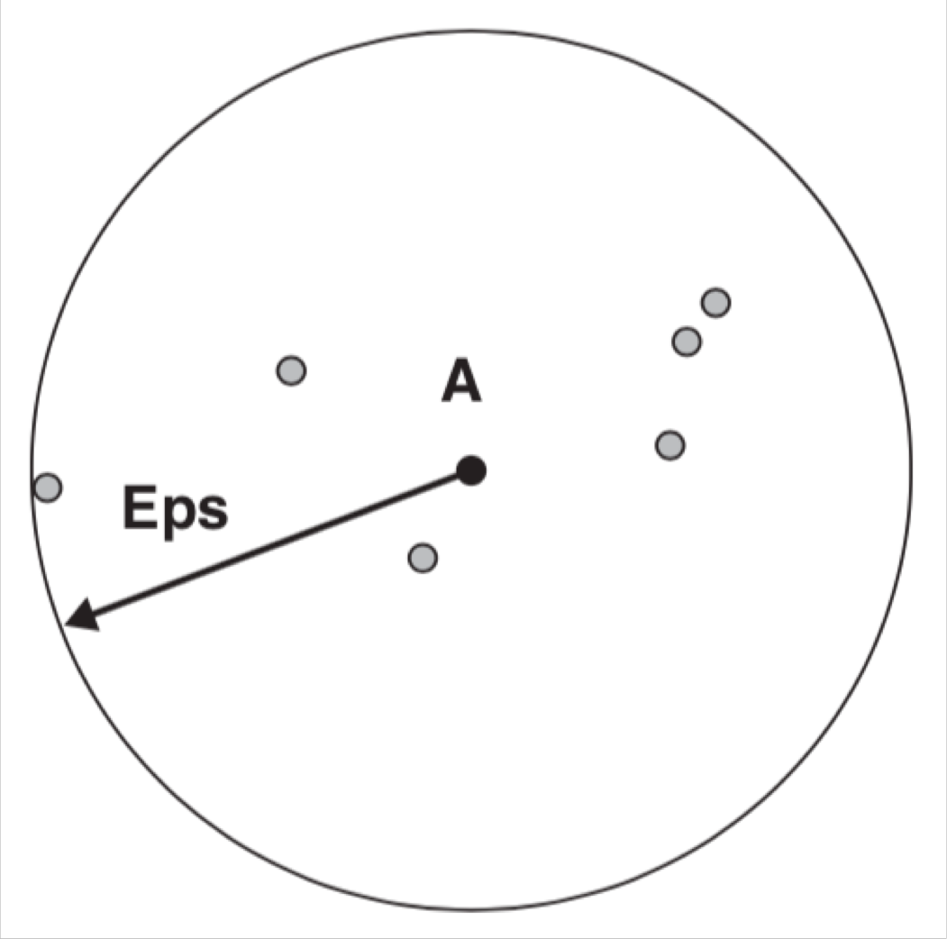
Density-based Clustering
• In the center-based approach, density is estimated for a particular point in the data set by counting the number of points within a specified radius (Eps) of that point (includes the point itself).
중심기반접근 방식에서, 밀도는 해당 포인트의 지정된 반경(EPS) 내의 포인트 수를 계산하여 데이터셋의 특정 포인트에 대해 추정함.
The number of points within a radius of Eps of point A is 7, including A itself.
자기자신을 포함하여 EPS 내에 7개가 있는 것

Slide 24
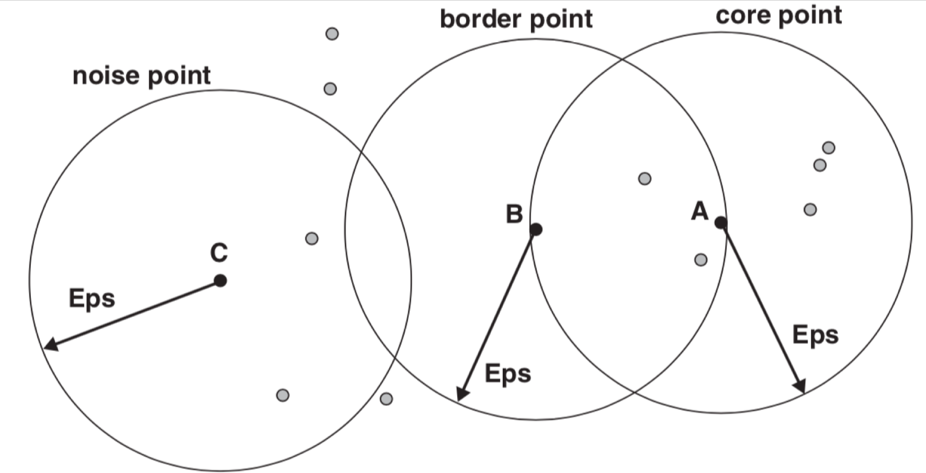
Density-based Clustering
• Classification of points according to center-based density
중심 밀도에 따른 포인트 분류
• Core points:These points are in the interior of a density-based cluster. A point is a core point if the number of points within a given neighborhood around the point as determined by the distance function, distance parameter, Eps, exceeds a certain threshold, MinPts.
• E.g., point A is a core point, for the indicated radius (Eps) if MinPts ≤ 7.
Core points :
주변에 임계값 이상의 포인트가 있는 것

Slide 25
Density-based Clustering
• Classification of points according to center-based density
• Border points: Falls within the neighborhood of a core point.
• E.g., Point B is a border point. A border point can fall within the neighborhoods of several core points.
• Noise points: A noise point is any point that is neither a core point nor a border point
Border points : 중심은 아닌데
중심 포인트의 이웃인 경우
Noise Point : 코어도, 보더도 아닌 경우

Slide 26
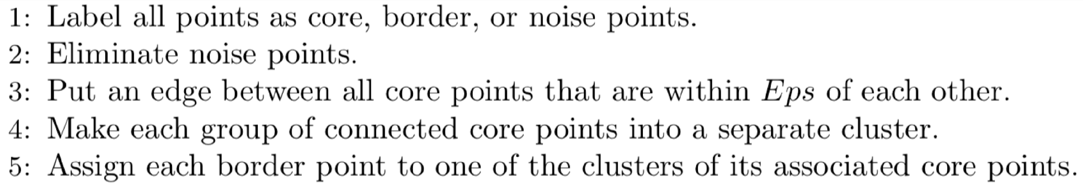
DBSCAN
• Density-based Spatial Clustering of Applications with Noise
노이즈 있는 경우의 DBSCAN
• Any two core points that are close enough—within a distance Eps of one another—are put in the same cluster.
서로 eps 내에 있는 두개의 코어 포인트는 동일한 클러스터
• Any border point that is close enough to a core point is put in the same cluster as the core point.
코어포인트와 가까운 경계 포인트들도 코어와 동일한 클러스터에 배치.
• Noise points are discarded. 노이즈는 삭제 된다.

Slide 27
DBSCAN
• Selection of DBSCAN parameters
• Eps
• MinPts
• An approach is to look at the behavior of the distance from a point to its kth nearest neighbor (k-dist).
한지점에서 k 번째 가까운 이웃 까지의 거리를 본다.
• For points that belong to some cluster, the value of k-dist is small.
• For points that are not in a cluster (e.g, noise points), k-dist is large.
어떤 클러스터에 속하는 경우 k-dist 가 작고, 아니면 k-dist 가 크다.

Slide 28
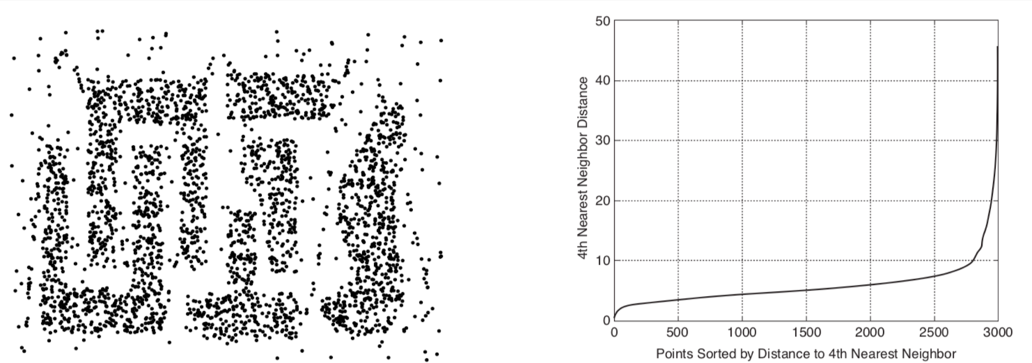
DBSCAN
• Selection of DBSCAN parameters
• Compute the k-dist for all the data points for some k.
일부 k 에 대한 모든 데이터 포인트에 대한 k-dist를 계산
• Sort them in increasing order and plot the sorted values.
오름차순으로 정렬하고 정렬된 값을 플로팅 함
• There is a sharp change at the value of k-dist that corresponds to a suitable value of Eps.
적절한 EPS 값에 해당될 때 k-dist 값에 급격한 변화가 있다.

Slide 29
DBSCAN
• Selection of DBSCAN parameters
• Select the distance as Eps and take the value of K as the MinPts.
거리를 Eps 로 설정하고 K 값을 minPts로 사용한다.
• Points for which k-dist is less than Eps will be labeled as core points, while other points will be labeled as noise or border points.
K-dist 가 EPS 보다 작은 포인트는 코어 포인트로 레이블이 지정되고 다른 포인트는 노이즈 또는 경계 포인트로 레이블이 지정된다.

Slide 30
DBSCAN
• Selection of DBSCAN parameters
• If the value of k is too small, then even a small number of closely spaced points that are noise or outliers will be incorrectly labeled as clusters.
K 작으면, 노이즈까지 들어오고
• If the value of k is too large, then small clusters (of size less than k) are likely to be labeled as noise.
K 크면 작은 클러스터들이 노이즈가 될 수 있다.
• The original DBSCAN algorithm used a value of k = 4, which appears to be a reasonable value for most two-dimensional data sets.
2차원 데이터셋에 대해 k=4 정도를 사용

Slide 31
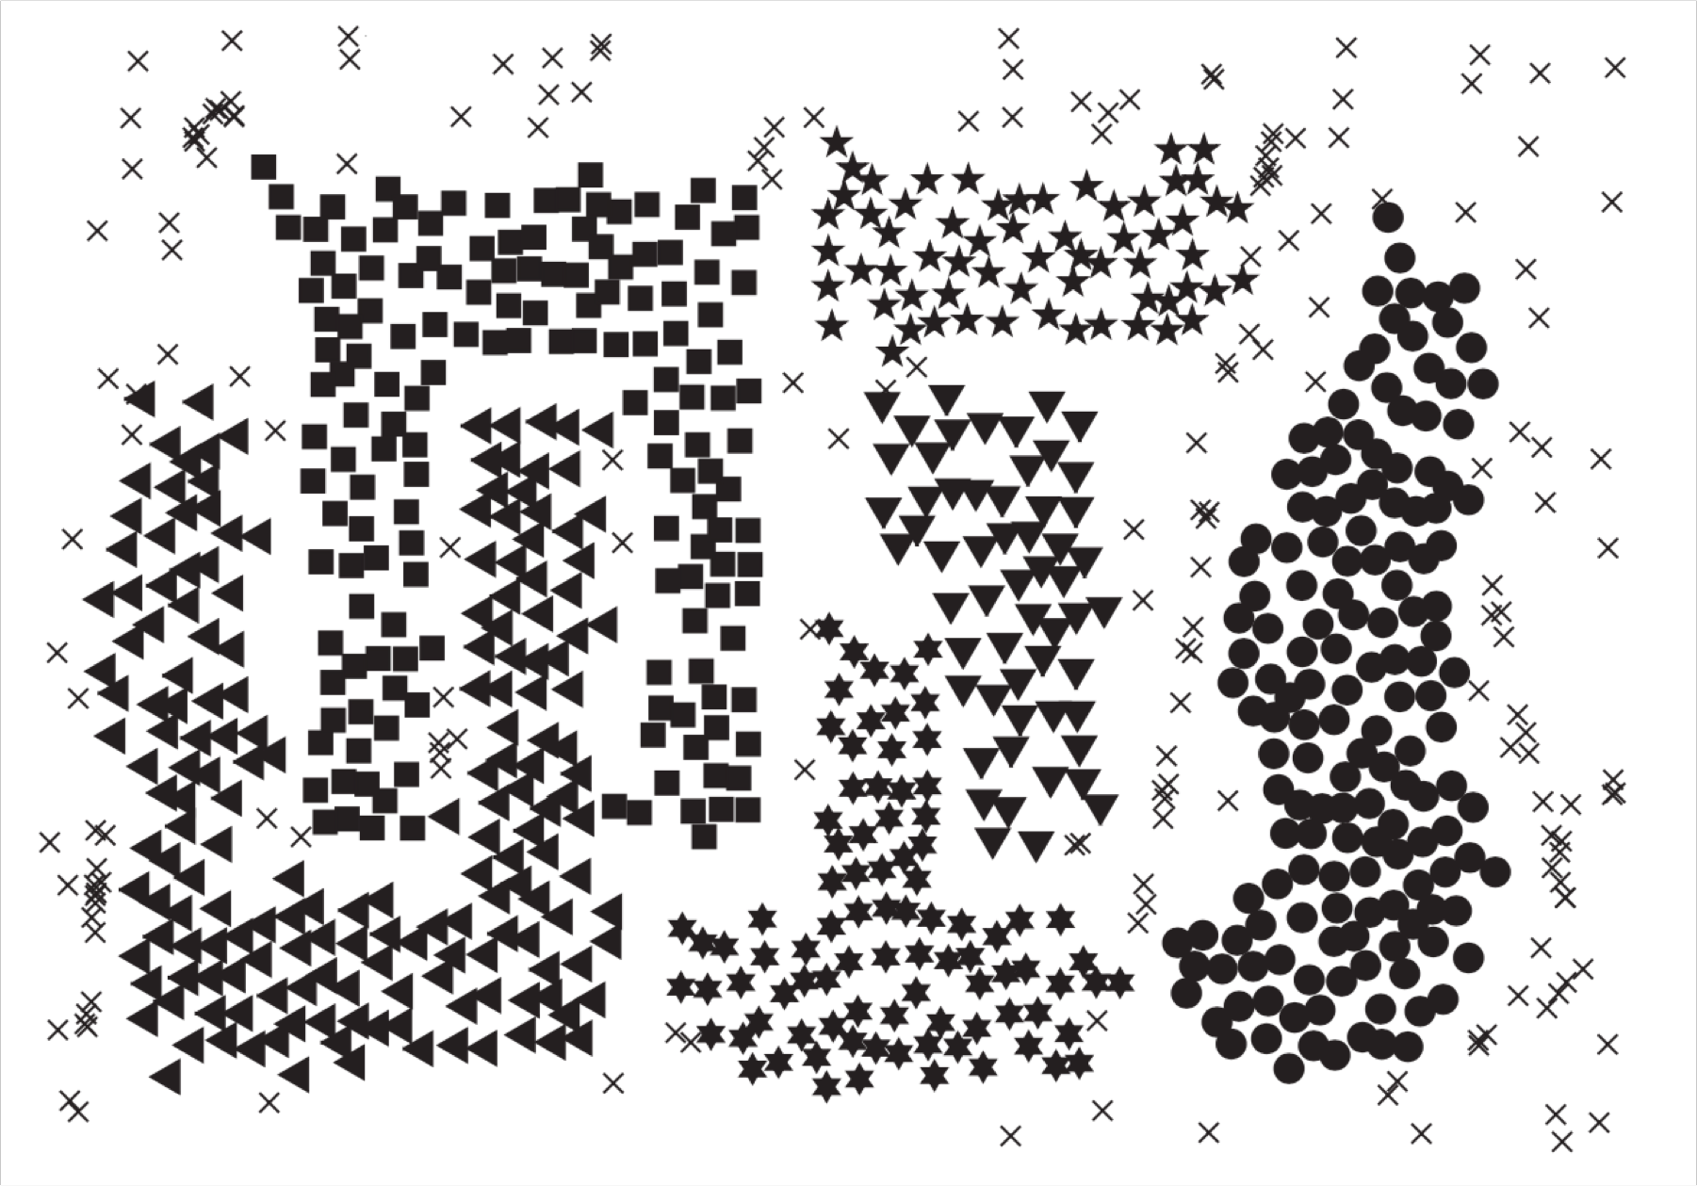
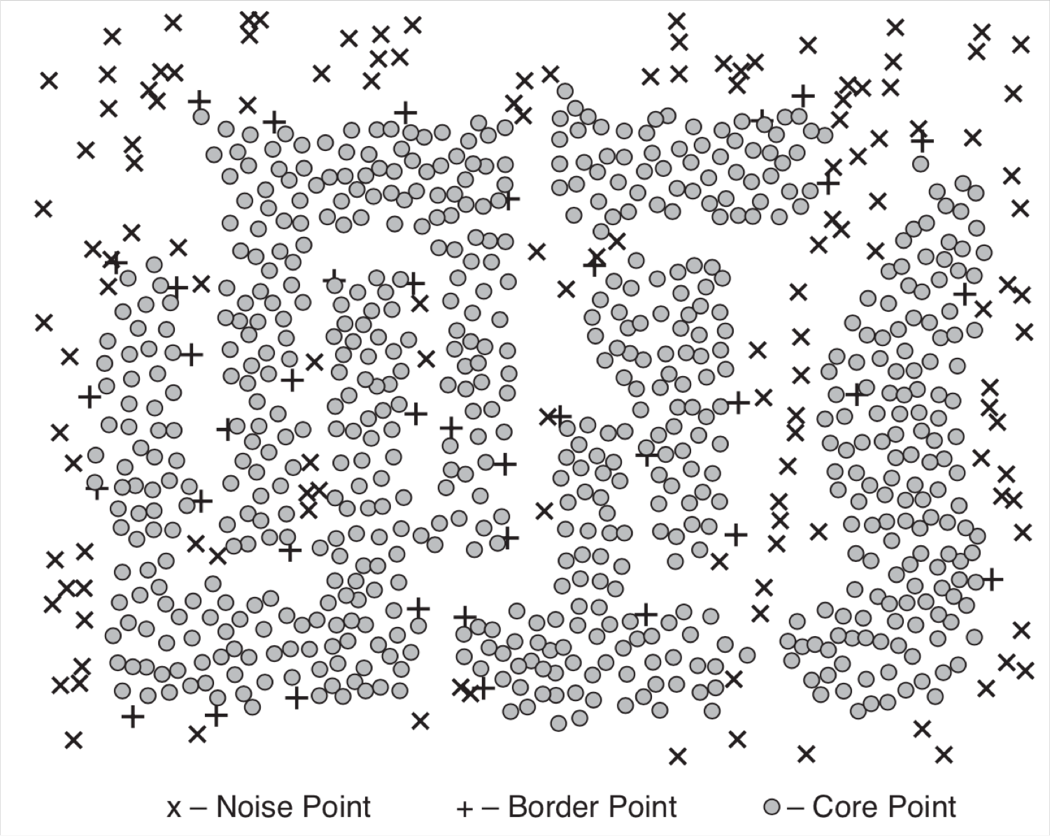
DBSCAN
• Example
• Eps = 10
• MinPts = 4

Slide 32
DBSCAN Issues
• DBSCAN has trouble when the clusters have widely varying densities.
• DBSCAN has trouble with high-dimensional data because density is more difficult to define for such data.
• DBSCAN can be expensive when the computation of nearest neighbors requires computing all pairwise proximities, as is usually the case for high-dimensional data.
• DBSCAN은 클러스터 밀도가 매우 다양할 때 문제가 발생합니다.
• DBSCAN은 고차원 데이터에 대해 밀도를 정의하기가 더 어렵기 때문에 고차원 데이터에 문제가 있습니다.
• DBSCAN은 일반적으로 고차원 데이터의 경우와 같이 최근접 이웃 계산에 모든 데이터간의 similarity 계산이 필요한 경우 비용이 많이 들 수 있습니다.

Slide 33
Cluster Evaluation

Slide 34
Cluster Evaluation
• Evaluation measures are classified into three types.
• Unsupervised: Measures the goodness of a clustering structure without respect to external information.
• Supervised: Measures the extent to which the clustering structure discovered by a clustering algorithm matches some external structure.
• Unsupervised: 외부 정보에 관계없이 클러스터링 구조의 양호도를 측정합니다.
• Supervised: 클러스터링 알고리즘에 의해 발견된 클러스터링 구조가 일부 외부 구조(원래 정답셋)와 일치하는 정도를 측정합니다

Slide 35
Unsupervised Cluster Evaluation
• Unsupervised measures are often called internal indices because they use only information present in the data set.)
(Indices 라고도 불리기도 한다.
• Cluster cohesion (compactness, tightness) 응집력 (컴팩트함, 견고함)
• Determines how closely related the objects in a cluster.
클러스터 개체가 얼마나 밀접하게 관련되어 있는지를 결정합니다.
• Cluster separation (isolation) 분리/격리
• Determines how distinct or well-separated a cluster is from other clusters.
한 클러스터가 다른 클러스터와 얼마나 구별되고 잘 분리되는지를 결정

Slide 36
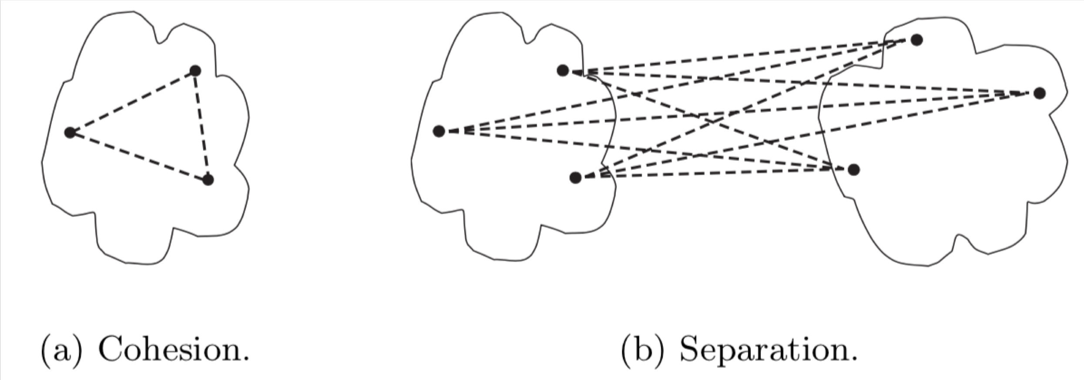
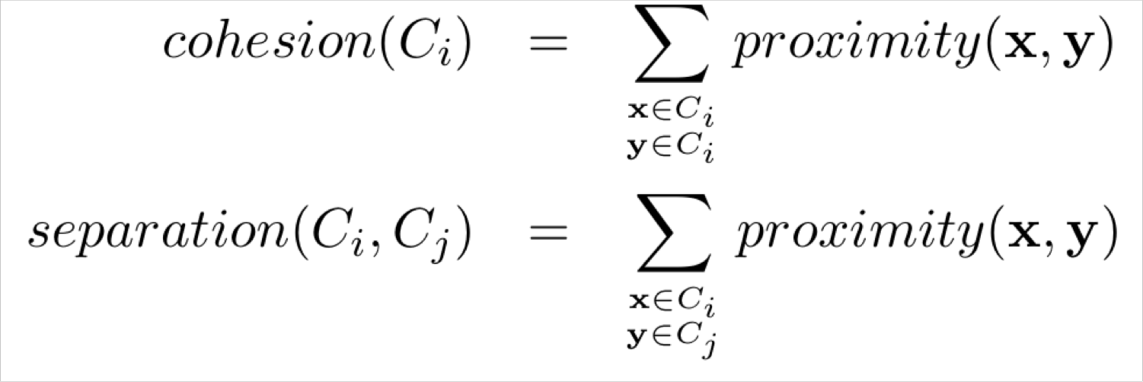
Cohesion and Separation (graph-based view)
• Cohesion of a cluster can be defined as the sum of the weights of the links that connect points within the cluster.
• Separation between two clusters can be measured by the sum of the weights of the links from points in one cluster to points in the other cluster.
• 클러스터의 응집력: 클러스터 내의 포인트를 연결하는 링크의 가중치의 합
.• 두 클러스터 간의 분리: 한 클러스터의 포인트에서 다른 클러스터의 포인트까지의 링크 가중치의 합

Slide 37
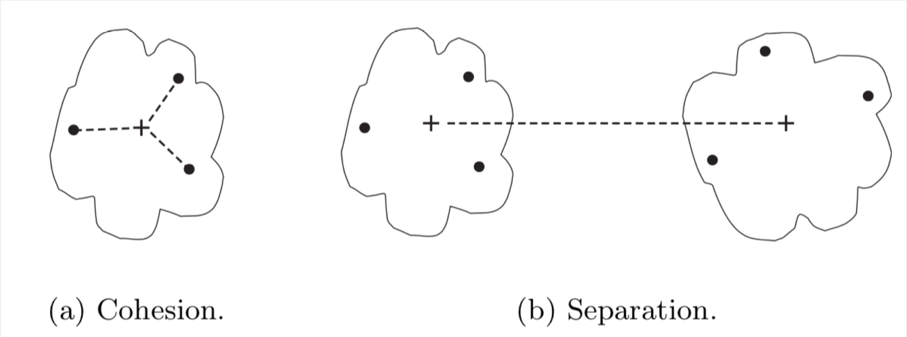
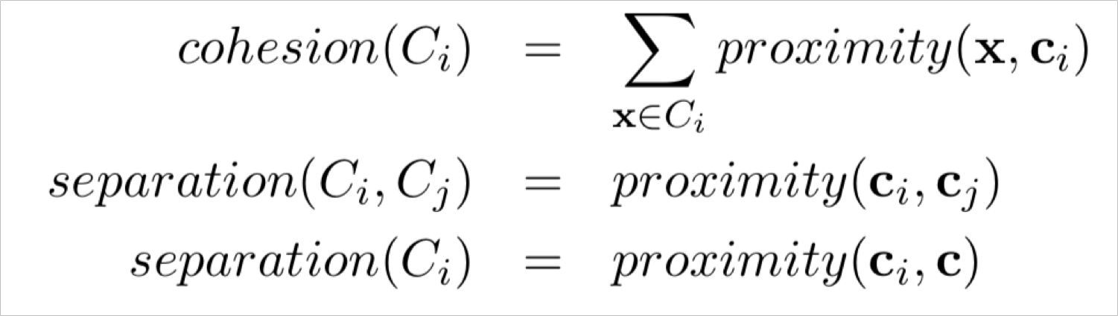
Cohesion and Separation (prototype-based view)
• Cohesion of a cluster can be defined as the sum of the proximities with respect to the prototype (centroid or medoid) of the cluster.
• Separation between two clusters can be measured by the proximity of the two cluster prototypes.
응집력 = 원형에 대한 접근성의 합
분리 = 두 클러스터 프로토타입의 근접성으로 측정
𝑐_{i} is the prototype (centroid) of cluster 𝐶_{i} and
𝑐 is the overall prototype (centroid)

Slide 38
Evaluating Individual Clusters and Objects
• Measures of the overall evaluation can be used to evaluate individual clusters and objects.
전체 평가의 측정값은 개별 클러스터 및 개체 평가에 사용 가능
• A cluster that has a high value of cohesion may be considered better than a cluster that has a lower value.
응집력 값이 높은 클러스터는 값이 낮은 클러스터보다 더 낮은 것으로 간주될 수 있음
• Can be used to improve the quality of a clustering.
• If a cluster is not very cohesive, then we may want to split it into several subclusters.
응집력이 높지 않으면 – 하위클러스터로 분할 가능
• If two clusters are relatively cohesive, but not well separated, we may want to merge them into a single cluster.
두 클러스터가 응집력은 있지만 분리가 잘 안되면 하나로 합칠 수 있음

Slide 39
Silhouette Coefficient (An individual point)
For the i^{𝑡h} object, calculate its average distance to all other objects in its cluster. Call this value 𝑎_{i}.
(i)th 개체의 경우 클러스터에 있는 다른 모든 개체까지의 평균 거리를 계산합니다. 이 값을 ai 라고 합니다.
For the i^{𝑡h} object and any cluster not containing the object, calculate the object’s average distance to all the objects in the given cluster. Find the minimum such value with respect to all clusters; call this value 𝑏_{i}.
(i)th 객체와 객체를 포함하지 않는 클러스터의 경우 주어진 클러스터의 모든 객체까지 객체의 평균거리를 계산합니다. 모든 클러스터에 대해 이러한 최소 값을 찾으십시오 이 값을 bi 라고 합니다.
For the i^{𝑡h} object, the silhouette coefficient is 𝑠_{I}

Slide 40
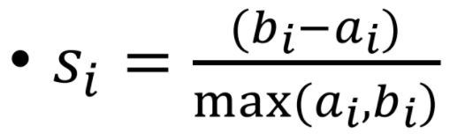
Silhouette Coefficient (An individual point)
• The value of the silhouette coefficient can vary between −1 and 1.
• When 𝑎_{i} = 0, the value is 1.
• When 𝑏_{i} = 0, the value is -1.
• A negative value is undesirable because this corresponds to a case in which 𝑎_{i} is greater than 𝑏_{i}.

Slide 41
Silhouette Coefficient (A Cluster)
• The average silhouette coefficient of a cluster is the average of the silhouette coefficients of points belonging to the cluster.
• An overall measure of the goodness of a clustering can be obtained by computing the average silhouette coefficient of all points.
• 클러스터의 평균 실루엣 계수: 클러스터에 속한 포인트들의 실루엣 계수의 평균.
• 클러스터링의 우수성에 대한 전반적인 측정은 모든 점의 평균 실루엣 계수를 계산하여 얻을 수 있습니다.

Slide 42
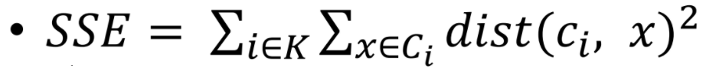
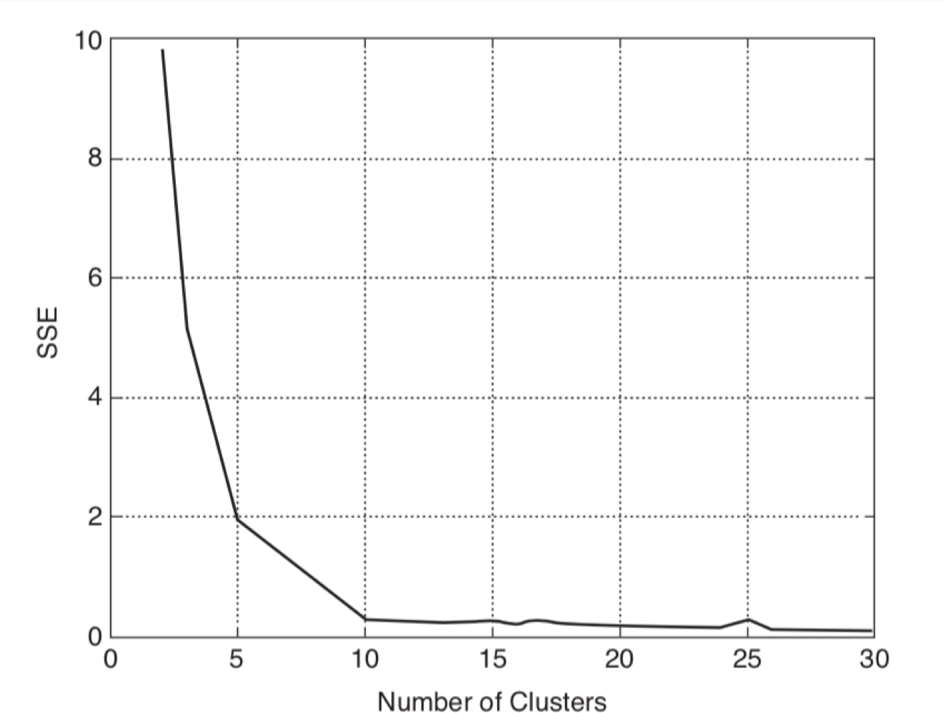
Determining the Correct Number of Clusters
• Sum of Squared Error (SSE)
, where 𝐾 is the number of clusters, 𝐶_{i} is the
i^{𝑡h} cluster, 𝑐_{i} is the centroid of of 𝐶 , 𝑥 is any point in 𝐶 .
i i
• A plot of the SSE versus the number of clusters.
• Find the natural number of clusters by looking for the number of clusters at which there is a knee, peak in the plot.

Slide 43
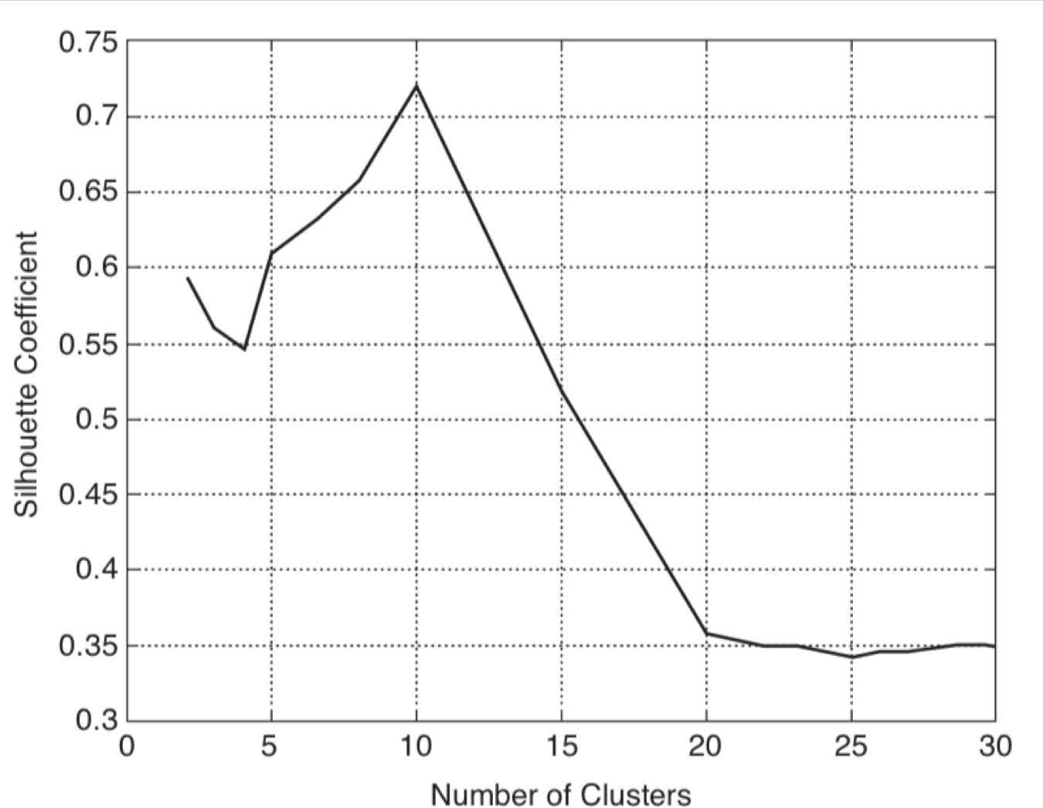
Determining the Correct Number of Clusters
• A plot of the average silhouette coefficient versus the number of clusters.
• Find the natural number of clusters by looking for the number of clusters at which there is a knee, peak in the plot.

Slide 44
Supervised Cluster Evaluation
• Classification-oriented
• Entropy
• Precision
• Recall
• F-measure
• Similarity-oriented
• Any two objects that are in the same cluster should be in the same class and vice versa.

Slide 45
Supervised Cluster Evaluation
• Similarity-oriented
• Cluster similarity matrix: Has a 1 in the ij^{𝑡h} entry if two objects, i and j, are in the same cluster and 0, otherwise.
• Class similarity matrix: Has a 1 in the ij^{𝑡h} entry if two objects, i and j, are in the same class and 0, otherwise.
• The correlation of the two matrices can be used as a measure of cluster validity.
두 행렬의 상관관계는 클러스터 유효성의 척도로 사용될 수 있습니다.

Slide 46
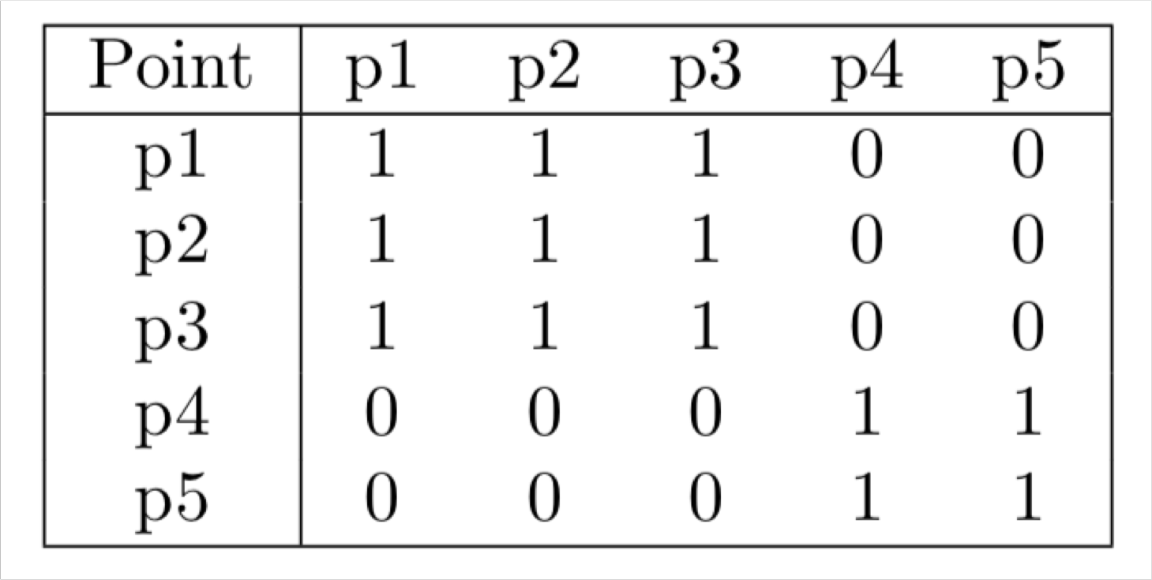
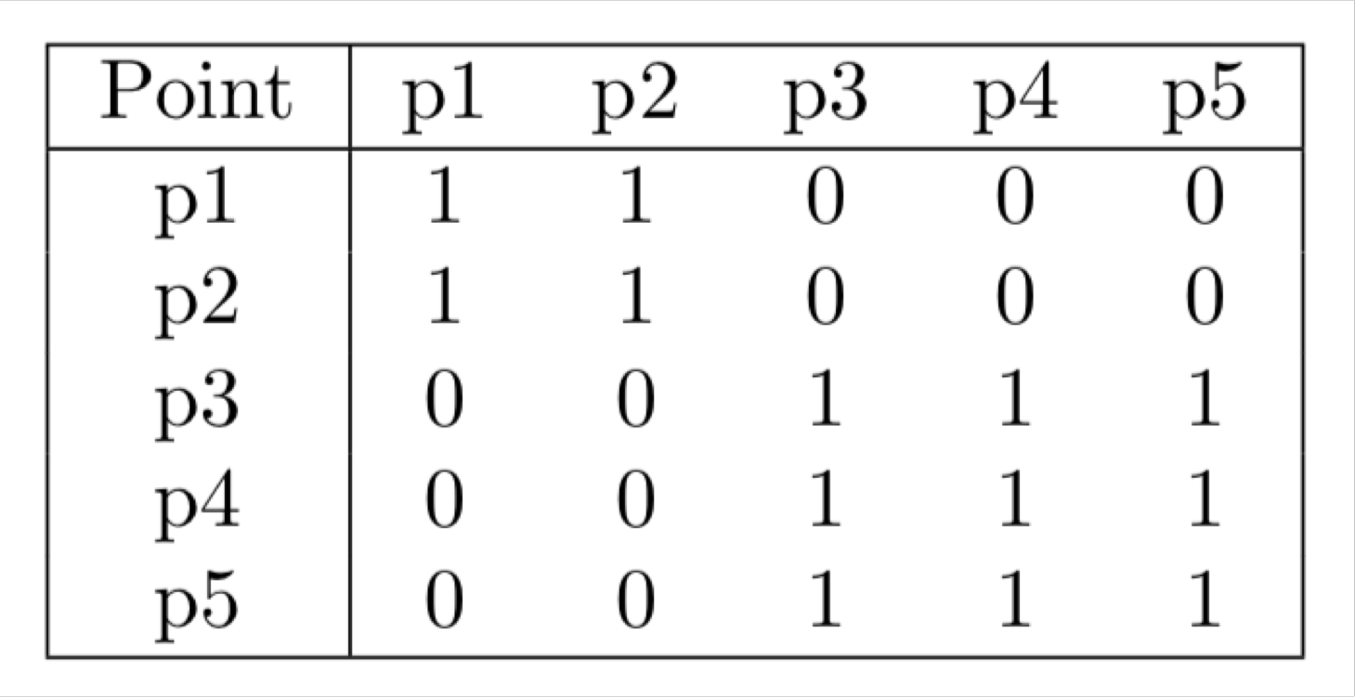
Supervised Cluster Evaluation
• Example
• Five data points, two clusters 𝐶₁ = {𝑝₁, 𝑝₂, 𝑝_{3 }}, 𝐶₂ = {𝑝₄, 𝑝₅}
• Five data points, two classes 𝐿₁ = {𝑝₁, 𝑝_{2 }}, 𝐿₂ = {𝑝₃, 𝑝₄, 𝑝₅}
• Correlation between the cluster similarity matrix and the class similarity matrix is 0.359.
cluster similarity matrix
class similarity matrix

Slide 47
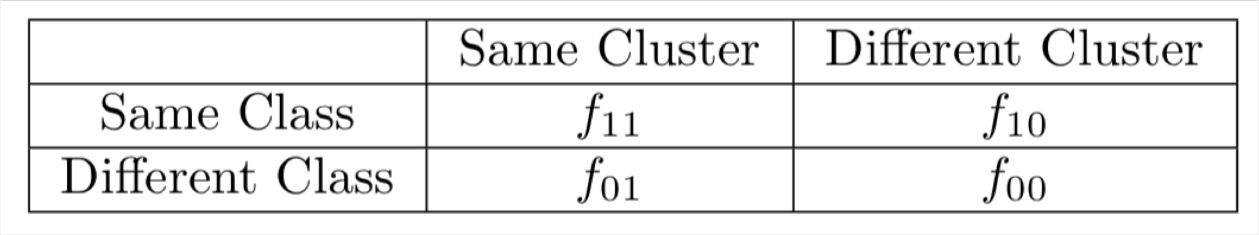
Supervised Cluster Evaluation
• Four quantities used to define similarity measures
• ƒ₀₀ = 𝑛𝑢𝑚𝑏𝑒𝑟 𝑜ƒ 𝑝𝑎i𝑟𝑠 𝑜ƒ 𝑜𝑏j𝑒𝑐𝑡𝑠 ℎ𝑎𝑣i𝑛𝑔 𝑎 𝑑i𝑓𝑓𝑒𝑟𝑒𝑛𝑡 𝑐𝑙𝑎𝑠𝑠 𝑎𝑛𝑑 𝑎 𝑑i𝑓𝑓𝑒𝑟𝑒𝑛𝑡 𝑐𝑙𝑢𝑠𝑡𝑒𝑟
• ƒ₀₁ = 𝑛𝑢𝑚𝑏𝑒𝑟 𝑜ƒ 𝑝𝑎i𝑟𝑠 𝑜ƒ 𝑜𝑏j𝑒𝑐𝑡𝑠 ℎ𝑎𝑣i𝑛𝑔 𝑎 𝑑i𝑓𝑓𝑒𝑟𝑒𝑛𝑡 𝑐𝑙𝑎𝑠𝑠 𝑎𝑛𝑑 𝑡h𝑒 𝑠𝑎𝑚𝑒 𝑐𝑙𝑢𝑠𝑡𝑒𝑟
• ƒ₁₀ = 𝑛𝑢𝑚𝑏𝑒𝑟 𝑜ƒ 𝑝𝑎i𝑟𝑠 𝑜ƒ 𝑜𝑏j𝑒𝑐𝑡𝑠 ℎ𝑎𝑣i𝑛𝑔 𝑡h𝑒 𝑠𝑎𝑚𝑒 𝑐𝑙𝑎𝑠𝑠 𝑎𝑛𝑑 𝑎 𝑑i𝑓𝑓𝑒𝑟𝑒𝑛𝑡 𝑐𝑙𝑢𝑠𝑡𝑒𝑟
• ƒ₁₁ = 𝑛𝑢𝑚𝑏𝑒𝑟 𝑜ƒ 𝑝𝑎i𝑟𝑠 𝑜ƒ 𝑜𝑏j𝑒𝑐𝑡𝑠 ℎ𝑎𝑣i𝑛𝑔 𝑡h𝑒 𝑠𝑎𝑚𝑒 𝑐𝑙𝑎𝑠𝑠 𝑎𝑛𝑑 𝑡h𝑒 𝑠𝑎𝑚𝑒 𝑐𝑙𝑢𝑠𝑡𝑒𝑟
• There are ^{𝑚(𝑚–1)} such pairs, if 𝑚 is the number of objects.
2

Slide 48
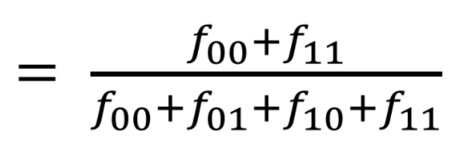
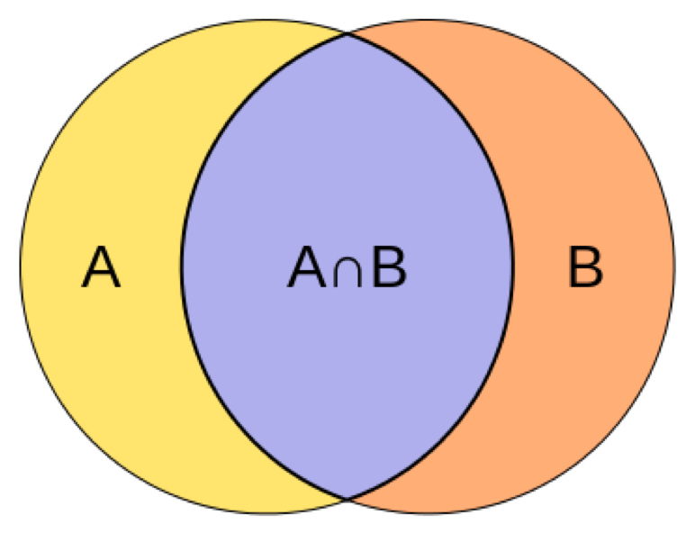
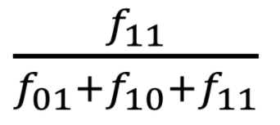
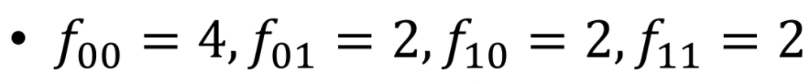
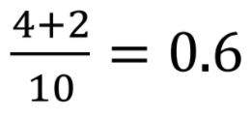
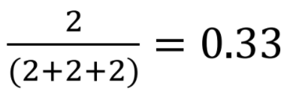
Supervised Cluster Evaluation
• 𝑅𝑎𝑛𝑑 i𝑛𝑑𝑒𝑥 =
(related to accuracy)
• 𝐽𝑎𝑐𝑐𝑎𝑟𝑑 𝑐𝑜𝑒ffi𝑐i𝑒𝑛𝑡 =
• Example
•Five data points, two clusters
•Five data points, two classes
•𝑅𝑎𝑛𝑑 i𝑛𝑑𝑒𝑥 =
•𝐽𝑎𝑐𝑐𝑎𝑟𝑑 𝑐𝑜𝑒ffi𝑐i𝑒𝑛𝑡 =

